Slide 1
Final Project Proposal
Team 4
b05902108 施承志
b05902036 夏瑜
b04502051 陳邦元

Slide 2
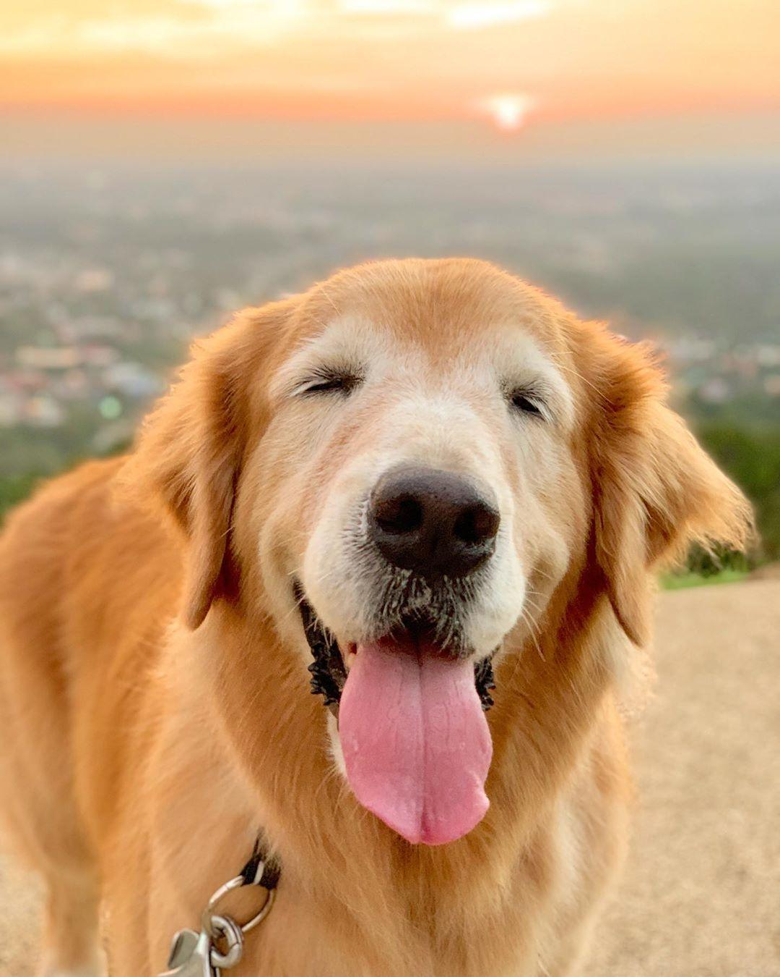

What
We’ll build an application on pioneer to achieve the followings:
Help people to find the target location they want to go
Guide people through the whole CS-building.
Proactively help people when they are in needs.
We call it CSIE-Retriever”.

Slide 3
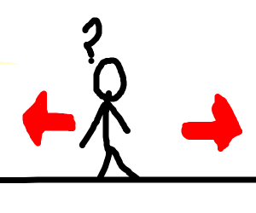
Why
Sometimes, some people want to visit CS-building but they don’t know where bathroom or elevator is. Additionally, lots of CS-students are too busy studying to help those people out. Therefore, with the aid of “CSIE-Retriever” , newcomers can immediately find the target and furthermore, or even have a thorough understanding of CS-building.

Slide 4
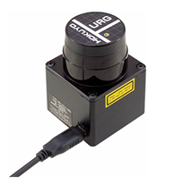
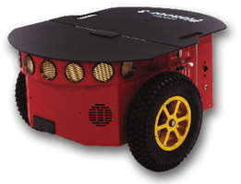
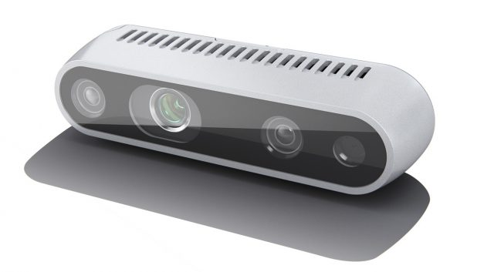


How
Hardware
Pioneer
Hokuyo URG-04LX-UG01
Realsense D435i
Software
ARIA Library
ROS
ROSARIA
p2os
slam-gmapping
...
Simulation
Gazebo

Slide 5
When (Schedule)
11/18 ~ 11/24 | setup environment for our pioneer (1)
11/25 ~ 12/1 | setup environment for our pioneer (2)
12/2 ~ 12/8 | survey speech recognition and natural language understandings
12/9 ~ 12/15 | porting SR and NLP services on our pioneer
12/16 ~ 12/22 | plan on how to guide people through CS-building
12/23 ~ 12/29 | refine our works
12/30 ~ 1/5 | add additional computer vision features (1)
1/6 ~ 1/12 | add additional computer vision features (2)
Notes:
Additional computer vision features: facing toward the person asking, according to the person’s condition (boy or girl, etc) (using computer vision), give out different solutions

Slide 6
Who
施承志：study topics mentioned, write codes
夏瑜：study topics mentioned, write codes
陳邦元 : study topics mentioned, write codes

